Slide 1

SCS 3214 Group Project II Group 25

Slide 2

UCSC Virtual Career Fair Management System

Slide 3

Our Team…..
Supervisor: Dr (Ms) L N C De Silva
Co-Supervisor: Mr. Roshan Abeyweera
Client: Miss. Nimali Wasana
P. H. Mallikarachchi 2018CS099 18000991
H.T.P.C. Sooriyabandara 2018CS164 18001645
H. P. N. Aravinda 2018CS015 18000152
W.G.S.L.Bandara 2018CS023 18000231
R. L. Udayanga 2018IS085 18020852

Slide 4
Introduction
The essential goal is to conduct and manage the UCSC virtual career fair for the PDC of UCSC
This system is to handle the UCSC career fair program by connecting all the stakeholders, including companies, PDC, final year undergraduates, and graduates.
We are going to offer a web-based software program system for PDC to handle candidate and company registration.
Companies can publish their advertisements.
Candidates can submit CVs, receive information relevant to job vacancies and apply for related job vacancies.
System facilitate companies to schedule and conduct career interviews during a specific period (Career Week).
System generate numerous reports required by PDC .

Slide 5

Problem Definition

Slide 6

In pandemic situation this event has a significant impact due to the banning of gatherings and social distancing.
Due to the space limitations in the physical setting, a limited number of participants can participate.
And there is not a proper way to find which student goes to which company
Which vacancies are still available
Which students are still available
PDC does not have a proper way to find stats about career fairs

Slide 7

Project Scope
Company
Relevant companies can publish their advertisement Upload video/other materials about the company and resources for candidates.
Schedule and notify candidates for interviews based on their availability.
Interface to interact with registered students.
Organizer
Request to companies and candidates to register for the career fair.

Slide 8
Students
Student can register to the system.
Can view job advertisements sorted as their preference.
Can view current available vacancies.
Allow students to upload their CVs according to their preferences.
Admin
Check and give the approval to users when they register in system.
Generate reports about system activities.

Slide 9




System Actors
Students
Company
Admin
Organizer

Slide 10

Goals and Objectives

Slide 11

Goals
Make a platform where virtual career fairs can be organized and conducted amidst the current situation in the country while adhering to physical distance. The virtual nature will also allow a broader community, both companies, and candidates to participate in the event without any significant restrictions.

Slide 12

Objectives
To provide user friendly, responsive and efficient system.
Connect all stakeholders, including companies, PDC, final year undergraduates, and graduates.
Handle candidate and company registration.
Facilitate candidates to submit CVs, receive information relevant to job vacancies, and apply for related job vacancies.
CV shortlisting and facilitate companies to schedule and conduct career interviews during a specific period (Career Week).
Generate numerous reports required by PDC for decision-making purposes and increase the traceability within the whole process.

Slide 13

Quality Attributes
Security
Modifiability
Usability
Availability
Reusability

Slide 14




Proposed Technologies
Frontend
Backend
Database
Version control
React
Reusable components and Dynamic content
Node.js
Many connections can be handled concurrently
MySQL
Database of the system is well structured because any unexpected data will not be input to the database and there will be relations between records
Git
We can track changes in our code across versions.

Slide 15

Feasibility Study

Slide 16

Technical Feasibility
Team members have experiences with using this technologies.
The web application will be hosted in a paid web hosting service with a suitable domain.
Developers have enough knowledge and suitable hardware to work with the select technologies.
Operational Feasibility
Easy to handle the system
All users have IT background
Most of user requirements are fulfilled
Users can enroll with the system under the restrictions provide with system

Slide 17

Economical Feasibility
Service Project
Free host server and free web development tools
No any financial cost
No need specific hardware components to works
Legal and Ethical Feasibility
Confidential and privacy of information

Slide 18
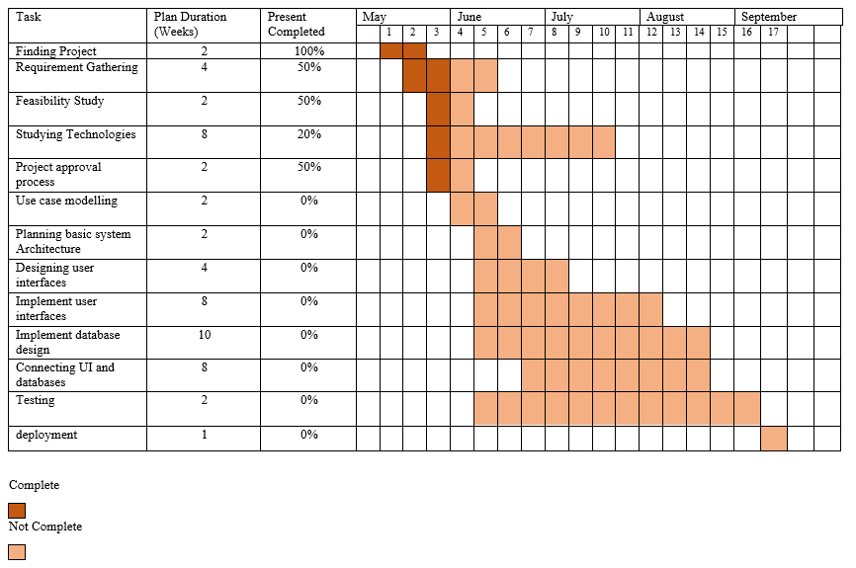
Schedule Feasibility

Slide 19
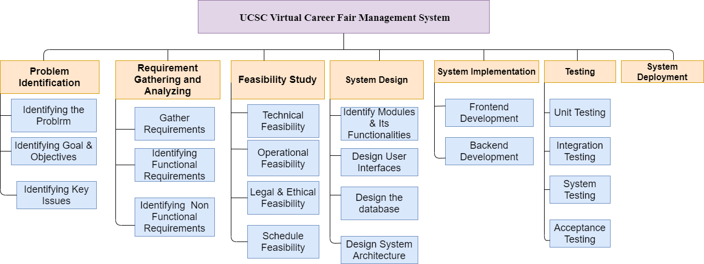

Slide 20
Time Estimation
The project is expected to be completed in 15 weeks.
Estimated man-hours for project completion:
Weekdays working hours = 3 hrs
Weekend working = 3 hrs
Number of members = 5
Man-hours per week = (3 + 3)*5 = 30hrs
Estimated number of weeks = 15 hrs
Estimated total of man-hours = 15*30 = 450 hrs

Slide 21

Thank You

